Slide 1

Data Structure (and Algorithm)

Slide 2
Graphs

Slide 3

WHAT IS GRAPH

Slide 4
What is Graph?
A graph is a formalism for representing relationships among items.
A graph is a pair: G = (V, E)
A set of vertices, also known
as nodes: V = {v₁,v₂,…,v_{n}}
A set of edges E = {e₁,e₂,…,e_{m}}
  Each edge e_{i} is a pair of vertices (v_{j},v_{k})
  An edge "connects" the vertices
Graphs can be directed or undirected
Hamza
Javed
Liaqat
V = {Hamza,Liaqat,Javed}
E = {(Javed,Liaqat),
(Hamza,Liaqat),
(Liaqat,Hamza)}

Slide 5
Graph Terminology
To make formulating graphs easy and standard, we have a lot of standard terminology for graphs

Slide 6
Definitions
Graph G consists of two finite sets V(G) and E(G)
Endpoints a set of one or two vertices of an edge
Loop an edge with just one endpoint
Parallel edges two distinct edges with same endpoints
Adjacent vertices vertices connected by an edge
Vertex adjacent to itself vertex endpoint of a loop
Adjacent edges two edges incident on the same endpoint
Isolated a vertex on which no edge is incident
Empty a graph with no vertices, otherwise nonempty.

Slide 7
Examples
Vertex set = {v₁, v₂, v₃, v₄, v₅, v₆}
Edge set = {e₁, e₂, e₃, e₄, e₅, e₆, e₇}
e₁, e₂, and e₃ are incident on v₁
v₂ and v₃ are adjacent to v₁
e_{2,}, e₃ and e₄ are adjacent to e₁
e₆ and e₇ are loops
e₂ and e₃ are parallel
v₅ and v₆ are adjacent to themselves
v₄ is an isolated vertex
Endpoint(e₅) = (v₅, v₆)
e₇
v₆
v₄
e₅
v₅
v₁
e₆
e₁
e₂
e₃
v₂
v₃
e₄

Slide 8
Some Graphs
For each example, what are the vertices and what are the edges?
Web pages with links
Facebook friends
Methods in a program that call each other
Road maps
Airline routes
Family trees
Course pre-requisites

Slide 9
Examples of Graphs
Molecular Structure
Computer Network
H
Server 1
Terminal 1
H
C
H
Terminal 2
H
Server 2
Other examples: electrical and communication networks, airline routes, flow chart, graphs for planning projects

Slide 10
Scratching the surface
Graphs are a powerful representation and have been studied deeply
Graph theory is a major branch of research in combinatorics and discrete mathematics
Every branch of computer science involves graph theory to some extent

Slide 11
Scratching the surface
Graphs are a powerful representation and have been studied deeply
Graph theory is a major branch of research in combinatorics and discrete mathematics
Every branch of computer science involves graph theory to some extent

Slide 12
Adjacent
Two nodes u and v are said to be adjacent if (u, v) ∈ E
v
(u, v)
u
u and v are adjacent
v and w are not adjacent
w

Slide 13
Undirected Graphs
In undirected graphs, edges have no specific direction
Edges are always "two-way"
Thus, (u, v) ∊ E implies (v, u) ∊ E.
Only one of these edges needs to be in the set
The other is implicit, so normalize how you check for it
Degree of a vertex: number of edges containing that vertex
Put another way: the number of adjacent vertices
D
A
C
B

Slide 14
Directed Graphs
In directed graphs (or digraphs), edges have direction
Thus, (u, v) ∊ E does not imply (v, u) ∊ E.
Let (u, v) ∈ E mean u → v
Call u the source and v the destination
In-Degree of a vertex: number of in-bound edges (edges where the vertex is the destination)
Out-Degree of a vertex: number of out-bound edges (edges where the vertex is the source)
D
D
A
A
C
or
C
B
B
2 edges here

Slide 15
Directed Graph(Digraph)
If (x, y) is a directed edge, we say
  y is adjacent to x
  y is successor of x
  x is predecessor of y
In a directed graph, directed path, directed cycle can be defined similarly
x
y

Slide 16
Weighted Graph
If each edge in G is assigned a weight, it is called a weighted graph
Islamabad
Bahawalpur
1000
2000
3500
Gilgit

Slide 17
Directed Graph(Digraph)
All previous graphs are undirected graph
If each edge in E has a direction, it is called a directed edge
A directed graph is a graph where every edges is a directed edge
Islamabad
Bahawalpur
1000
Directed edge
2000
3500
Gilgit

Slide 18
Sub Graph
A subgraph of a graph G =(V, E) is a graph H = (U, F) such that U ⊆ V and F ⊆ E.
v₂
v₂
v₁
v₃
v₃
v₅
v₅
v₄
v₄
G
H

Slide 19
Property of a Graph
A undirected graph that is connected and has no cycle is a tree.
A tree with n nodes have exactly n-1 edges.
A connected undirected graph with n nodes must have at least n-1 edges.
Notes:
Not too useful!!

Slide 20
A Graph ADT?
We can think of graphs as an ADT
Operations would inlude isEdge(v_{j},v_{k})
But it is unclear what the "standard operations" would be for such an ADT
Instead we tend to develop algorithms over graphs and then use data structures that are efficient for those algorithms
Many important problems can be solved by:
Formulating them in terms of graphs
Applying a standard graph algorithm

Slide 21
Your Turn
A power distribution network consists of 8 consumption points labeled A to H. The details of the connections between the consumption points and their respective distances are provided below:
  A <-> C: 15 miles, B <-> C: 20 miles, B <-> D: 25 miles,
  C <-> E: 30 miles, D <-> E: 35 miles, E <-> F: 40 miles, E <-> G: 45 miles,
  F <-> G: 50 miles, F <-> H: 55 miles, G <-> H: 60 miles
Represent above information as a linked list of wheated undirected graph.
Draw an undirected graph based on the information given above, clearly showing all the connections and distances between the consumption points.

Slide 22
How we represent it?

Slide 23
Representations of Graphs
Two standard ways to represent a graph
  Adjacency Matrix
  Adjacency lists
Applicable to directed and undirected graphs.

Slide 24
Representations of Graphs
Adjacency matrix
A graph G(V, E) assuming the vertices are numbered 1, 2, 3, … , |V| in some arbitrary manner, then representation of G consists of: |V| × |V| matrix A = (a_{ij}) such that
1 if (i, j) € E
0 otherwise
Preferred when graph is dense
  |E| is close to |V|²

Slide 25
Adjacency matrix of undirected
1
2
3
5
4

Slide 26
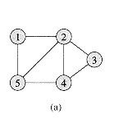
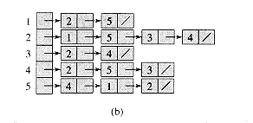
Representations of Graphs
Adjacency lists
Graph G(V, E) is represented by array Adj of |V| lists
For each u € V, the adjacency list Adj[u] consists of all the vertices adjacent to u in G
A compact way to represent sparse graphs.
    |E| is much less than |V|²
The amount of memory required is: (V + E)

Slide 27
Implementing Graph
Adjacency matrix
  Represent a graph using a two-dimensional array
Adjacency list
  Represent a graph using n linked lists where n is the number of vertices

Slide 28
Adjacency Matrix for directed graph
Matrix[i][j] = 1 if (v_{i}, v_{j})∈E
0 if (v_{i}, v_{j})∉E
 |  | 1 | 2 | 3 | 4 | 5
 |  | v₁ | v₂ | v₃ | v₄ | v₅
1 | v₁ | 0 | 1 | 0 | 0 | 0
2 | v₂ | 0 | 0 | 0 | 1 | 0
3 | v₃ | 0 | 1 | 0 | 1 | 0
4 | v₄ | 0 | 0 | 0 | 0 | 0
5 | v₅ | 0 | 0 | 1 | 1 | 0
v₂
v₁
v₃
v₅
v₄
G

Slide 29
Adjacency Matrix for undirected weighted graph
Matrix[i][j] = w(v_{i}, v_{j}) if (v_{i}, v_{j})∈E or (v_{j}, v_{i})∈E
∞ otherwise
 |  | 1 | 2 | 3 | 4 | 5
 |  | v₁ | v₂ | v₃ | v₄ | v₅
1 | v₁ | ∞ | 5 | ∞ | ∞ | ∞
2 | v₂ | 5 | ∞ | 2 | 4 | ∞
3 | v₃ | ∞ | 2 | ∞ | 3 | 7
4 | v₄ | ∞ | 4 | 3 | ∞ | 8
5 | v₅ | ∞ | ∞ | 7 | 8 | ∞
v₂
v₁
v₃
5
2
4
3
7
v₅
v₄
8
G

Slide 30
Adjacency List for directed graph
1 | v₁ | → | v₂
2 | v₂ | → | v₄
3 | v₃ | → | v₂ | → | v₄
4 | v₄
5 | v₅ | → | v₃ | → | v₄
v₂
v₁
v₃
v₅
v₄
G

Slide 31
Adjacency List for undirected weighted graph
v₂
v₁
v₃
1 | v₁ | → | v₂(5)
2 | v₂ | → | v₁(5) | → | v₃(2) | → | v₄(4)
3 | v₃ | → | v₂(2) | → | v₄(3) | → | v₅(7)
4 | v₄ | → | v₂(4) | → | v₃(3) | → | v₅(8)
5 | v₅ | → | v₃(7) | → | v₄(8)
2
5
4
3
7
v₅
v₄
8
G

Slide 32
Pros and Cons
Adjacency matrix
  Allows us to determine whether there is an edge from node i to node j in O(1) time
Adjacency list
  Allows us to find all nodes adjacent to a given node j efficiently
  If the graph is sparse, adjacency list requires less space

Slide 33
Problems related to graph
Graph Traversal
Spanning Tree
Minimum Spanning Tree
Shortest Path

Slide 34
Applications of Graphs: Traversals

Slide 35
Graph Traversal Algorithms
To traverse a tree, we use tree traversal algorithms like pre-order, in-order, and post-order to visit all the nodes in a tree.
Similarly, graph traversal algorithm tries to visit all the nodes it can reach.
If a graph is disconnected, a graph traversal that begins at a node v will visit only a subset of nodes, that is, the connected component containing v.

Slide 36
Graph Traversal
Basic Algorithm for Traversals:
Select a starting node
Make a set of nodes adjacent to current node
Visit each node in the set but "mark" each nodes after visiting them so you don't revisit them (and eventually stop)
Repeat above but skip "marked nodes"

Slide 37
Two basic Traversal Algorithms
Two basic graph traversal algorithms:
  Depth-first-search (DFS)
    After visit node v, DFS strategy proceeds along a path from v as deeply into the graph as possible before backing up
  Breadth-first-search (BFS)
    After visit node v, BFS strategy visits every node adjacent to v before visiting any other nodes

Slide 38
Depth First Search
Idea: traverse “deeper” whenever possible.
On each iteration, the algorithm proceeds to an unvisited vertex that is adjacent to the one it is currently in.
  If there are more than more neighbors, break the tie by the alphabetic order of the vertices.
When reaching a dead end(a vertex with no adjacent unvisited vertices), the algorithm backs up one edge to the parent and tries to continue visiting unvisited vertices from there.
The algorithm halts after backing up to the starting vertex, with the latter being a dead end.

Slide 39
Depth First Search(DFS)
DFS strategy looks similar to pre-order. From a given node v, it first visits itself. Then, recursively visit its unvisited neighbours one by one.
DFS can be defined recursively as follows.
Algorithm dfs(v)
print v; // you can do other things!
mark v as visited;
for (each unvisited node u adjacent to v)
dfs(u);

Slide 40
Depth First Search(DFS):Example
Start from v₃
1
v₃
v₂
2
v₂
v₁
v₃
x
x
x
3
4
x
v₁
v₄
x
v₅
v₄
5
G
v₅

Slide 41
Recursive Depth First Search: Example with tree
A tree is a graph and DFS and BFS are particularly easy to "see" in one
Order processed: A, B, D, E, C, F, G, H
This is a "pre-order traversal" for trees
The marking is unneeded here but because we support arbitrary graphs, we need a means to process each node exactly once
void DFS(int start) {
visited[start] = true;
cout << "Visited: " << start << endl;
for (int i = 0; i < adj[start].size(); i++) {
int u = adj[start][i];
if (!visited[u]) {
DFS(u);
}
}
}
A
B
C
vector<vector<int>> adj = {
{1, 2}, // A (0) -> B (1), C (2)
{0, 3, 4}, // B (1) -> A (0), D (3), E (4)
{0, 5}, // C (2) -> A (0), F (5)
{1}, // D (3) -> B (1)
{1}, // E (4) -> B (1)
{2, 6, 7}, // F (5) -> C (2), G (6), H (7)
{5}, // G (6) -> F (5)
{5} // H (7) -> F (5)
};
D
E
F
G
H

Slide 42
Depth First Search
Idea:
  traverse “deeper” whenever possible.
  On each iteration, the algorithm proceeds to an unvisited vertex that is adjacent to the one it is currently in. If there are more than more neighbors, break the tie by the alphabetic order of the vertices.
  When reaching a dead end(a vertex with no adjacent unvisited vertices), the algorithm backs up one edge to the parent and tries to continue visiting unvisited vertices from there.
  The algorithm halts after backing up to the starting vertex, with the latter being a dead end.
Similar to preorder tree traversals
It’s convenient to use a stack to trace the operation of depth-first search.
  Push a vertex onto the stack when the vertex is reached for the first time.
  Pop a vertex off the stack when it becomes a dead end.

Slide 43
Non Recursive version of DFS Algorithm
Algorithm dfs(v)
s.createStack();
s.push(v);
mark v as visited;
while (!s.isEmpty()) {
let x be the node on the top of the stack s;
if (no unvisited nodes are adjacent to x)
s.pop(); // blacktrack
else {
select an unvisited node u adjacent to x;
s.push(u);
mark u as visited;
}
}

Slide 44
Iterative DFS Function
void iterativeDFS(int start, vector<vector<int>>& adj, vector<bool>& visited) {
stack<int> s; // Initialize a stack for DFS
s.push(start); // Push the starting node onto the stack
while (!s.empty()) {
int v = s.top(); // Get the top element of the stack
s.pop(); // Remove the top element from the stack
if (!visited[v]) { // If the node has not been visited
cout << v << " "; // Process the node (print it)
visited[v] = true; // Mark the node as visited
}
for (int i = 0; i < adj[v].size(); i++) {//Loop through all neighbors of the current node
int u = adj[v][i];
if (!visited[u]) { // If the neighbor hasn't been visited
s.push(u); // Push the neighbor onto the stack for future exploration
}
}
}
}
int main() {
int nodes = 4; // total number of nodes, labeled from 0 to 5
vector<vector<int>> adj(nodes);
// Creating an undirected graph (example)
adj[0] = {1, 2};
adj[1] = {0, 3};
adj[2] = {0};
adj[3] = {1};
vector<bool> visited(nodes, false);
int startNode = 0;
cout << "DFS traversal starting from node " << startNode << ": ";
iterativeDFS(startNode, adj, visited);
cout << endl;
return 0;
}

Slide 45
Non- Recursive DFS Example
visit | stack
v₃ | v₃
v₂ | v₃, v₂
v₁ | v₃, v₂, v₁
backtrack | v₃, v₂
v₄ | v₃, v₂, v₄
v₅ | v₃, v₂, v₄ , v₅
backtrack | v₃, v₂, v₄
backtrack | v₃, v₂
backtrack | v₃
backtrack | empty
v₂
v₁
v₃
x
x
x
x
x
v₅
v₄
G

Slide 46
Breadth First Search(BFS)
The idea
  Traverse “wider” whenever possible.
  Discover all vertices at distance k from s (on level k) before discovering any vertices at distance k +1 (at level k+1)
Similar to level-by-level tree traversals
Instead of a stack, breadth-first uses a queue.

Slide 47
Breadth First Search(BFS)
BFS strategy looks similar to level-order. From a given node v, it first visits itself. Then, it visits every node adjacent to v before visiting any other nodes.
  1. Visit v
  2. Visit all v’s neigbours
  3. Visit all v’s neighbours’ neighbours
  …
Similar to level-order, BFS is based on a queue.

Slide 48
Breadth First Search(BFS) Example
Start from v₅
Visit | Queue (front to back)
v₅ | v₅
 | empty
v₃ | v₃
v₄ | v₃, v₄
 | v₄
v₂ | v₄, v₂
 | v₂
 | empty
v₁ | v₁
 | empty
1
v₅
v₂
v₃
v₁
x
x
2
3
x
v₃
v₄
x
x
4
v₄
v₂
v₅
G
5
v₁

Slide 49
BFS With queue: Example with tree
void BFS(int start, vector<vector<int>>& adj, vector<bool>& visited) {
queue<int> q;
visited[start] = true;
q.push(start);
while (!q.empty()) {
int v = q.front();
q.pop();
cout << v << " ";
for (int i = 0; i < adj[v].size(); i++) {
int u = adj[v][i];
if (!visited[u]) {
visited[u] = true;
q.push(u);
}
}
}
}
A
B
C
D
E
F
G
H
vector<vector<int>> adj = {
{1, 2}, // A (0) -> B (1), C (2)
{0, 3, 4}, // B (1) -> A (0), D (3), E (4)
{0, 5}, // C (2) -> A (0), F (5)
{1}, // D (3) -> B (1)
{1}, // E (4) -> B (1)
{2, 6, 7}, // F (5) -> C (2), G (6), H (7)
{5}, // G (6) -> F (5)
{5} // H (7) -> F (5)
};
Order processed: A, B, C, D, E, F, G, H
A "level-order" traversal

Slide 50
Applications of Graphs: SPANNING TREE

Slide 51
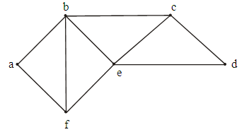
Motivation
  Suppose it is required to develop a system of roads between six major cities. A survey of the area revealed that only the roads shown in the graph could be constructed.
  For economic reasons, it is desired to construct the least possible number of roads to connect the six cities.
    How we do this task?

Slide 52
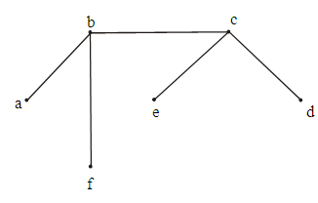
Reduction of data size
One such set of roads is:
  The graph representing these roads is :
    Sub-graph
    Connected
    circuit-free (six vertices and five edges)
connected & circuit-free graph is a tree

Slide 53
Spanning Tree
A spanning tree for a graph G is
  a sub graph of G that contains every vertex of G
  It is a tree.

Slide 54
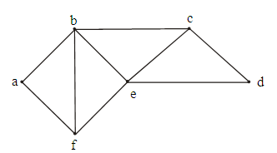
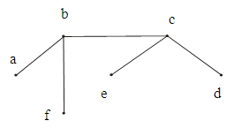
Spanning Tree
How we find Spanning Tree?
  Delete an edge in each cycle.
  Which edge should we remove from given graph so that it become a spanning tree?
  1. Delete a-f 2. Delete f-e
  3. Delete b-e 4. Delete e-d
  The associated spanning tree is
How many edge should we remove?
  The graph has 6 vertices & 9 edges so we must delete 9 - 6 + 1 = 4 edges. [e-v+1]

Slide 55
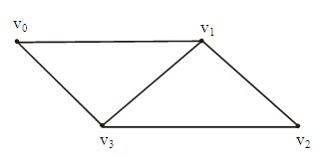
An other Example
Find all the spanning trees of the graph given below.

Slide 56
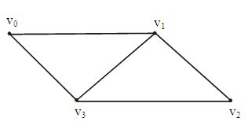
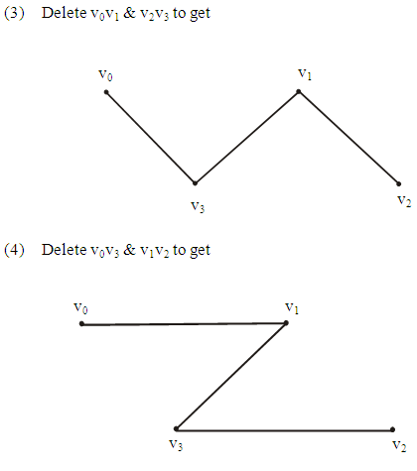
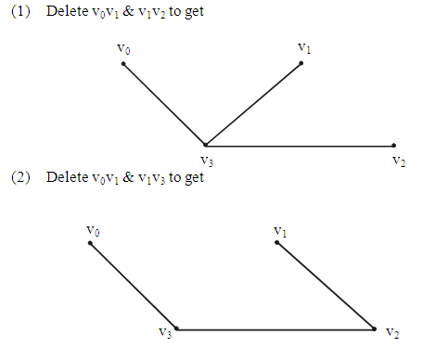
Solution

Slide 57
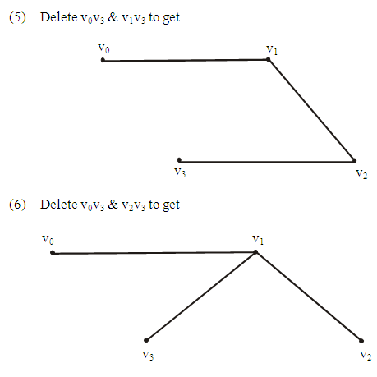
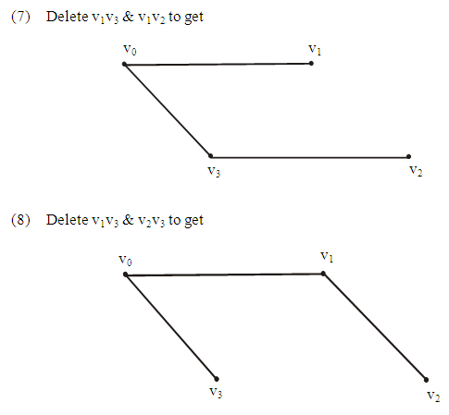
Solution

Slide 58
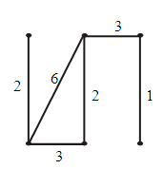
Weighted graph
Definition
  A weighted graph is a graph for which each edge has an associated real number weight.
  The sum of the weights of all the edges is the total weight of the graph.
    The weight of above graph:
  2 + 6 + 3 + 2 + 3 + 1 = 17

Slide 59
Minimum Spanning Tree?
A Minimal Spanning Tree(MST) for a weighted graph is a spanning tree that has the least possible total weight compared to all other spanning trees of the graph.
If G is a weighted graph and e is an edge of G then w(e) denotes the weight of e and w(G) denotes the total weight of G.

Slide 60
Example
Find MST of the following weighted graph?
Brute Force Approach
  What if we find all distinct
  spanning trees of a given graph
  using any approach and then
  select the one with minimum
  weight?
  Why is this approach, which looks at all possible solutions and then selects the one of our choice, not feasible (although it is correct)?

Slide 61
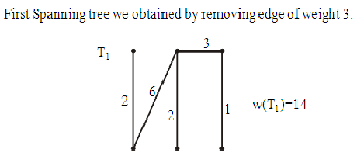
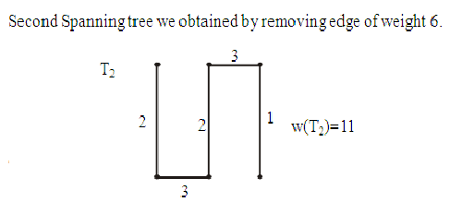
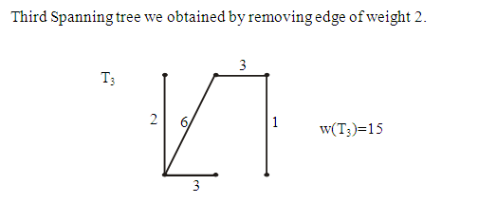
Solution
  T₂ is the minimal spanning tree, since it has the minimum weight among the spanning trees.
Notes:
Start of Lecture 26

Slide 62
Greedy approach
Let us discuss two procedures:
  Cutting Edges
  Growing Edges

Slide 63
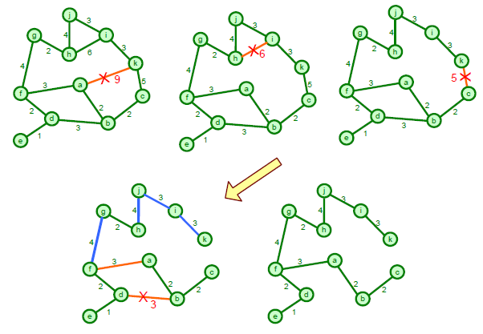
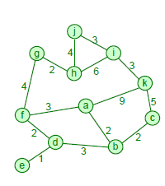
Cutting Edge
Basic Idea: Remove all redundant edges from a given graph:
  cutting the edges with maximum weight provided it does not disconnect the graph

Slide 64
Growing Edge
Basic Idea: Grow edges starting from the edge of minimum weight (making sure no cycle is created).
  Start with no edges at all but with p isolated vertices.
  Add edges out of the edge pool of the graph such that the resulting graph remains a tree.
How this approach differ from cutting edge?
  opposite to the one discussed above
  instead of pruning we are growing edges.
In the cutting edge approach we should be careful and
should not disconnect the graph.
In the growing edge approach we should be careful not
to create cycles in the graph.

Slide 65
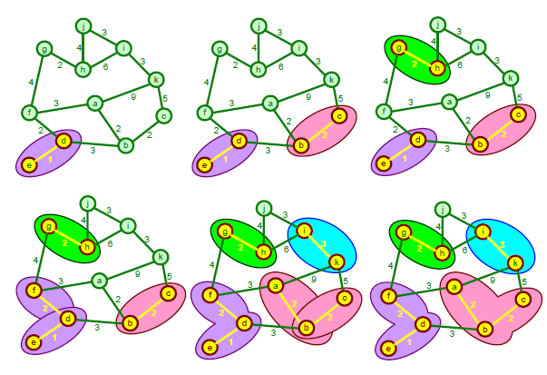
Growing Edge

Slide 66
Input: G [a weighted graph with n vertices]
Algorithm:
1. Initialize T(the minimal spanning tree of G) to have all the vertices of G and no edges.
2. Let E be the set of all edges of G and let m: = 0.
3. While (m < n - 1)
3a. Find an edge e in E of least weight.
3b. Delete e from E.
3c. If addition of e to the edge set of T does not produce a circuit then add e to the edge set of T and set m: = m + 1
end while
Output T
end Algorithm

Slide 67
Kruskal’s Algorithm
Edges | Weight
(g, h) | 1
(c, i) | 2
(f, g) | 2
(a, b) | 4
(c, f) | 4
(g, i) | 6
(c, d) | 7
(h, i) | 7
(a, h) | 8
(b, c) | 8
(d, e) | 9
(e, f) | 10
(b h) | 11
(d, f) | 14
8
7
b
c
d
4
9
2
a
i
4
14
e
11
6
8
7
10
h
g
f
1
2

Slide 68
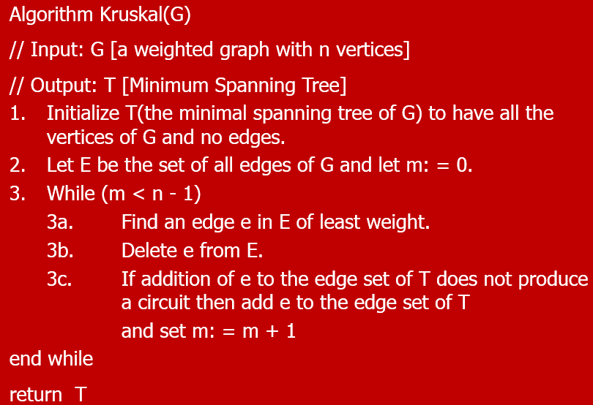
Kruskal’s Algorithm
8
7
b
c
d
4
9
2
a
i
4
14
e
11
6
8
7
10
h
g
f
1
2

Slide 69
Kruskal’s Algorithm
8
7
b
c
d
4
9
2
a
i
4
14
e
11
6
8
7
10
h
g
f
1
2

Slide 70
Kruskal’s Algorithm
8
7
b
c
d
4
9
2
a
i
4
14
e
11
6
8
7
10
h
g
f
1
2

Slide 71
Kruskal’s Algorithm
8
7
b
c
d
4
9
2
a
i
4
14
e
11
6
8
7
10
h
g
f
1
2

Slide 72
Kruskal’s Algorithm
8
7
b
c
d
4
9
2
a
i
4
14
e
11
6
8
7
10
h
g
f
1
2

Slide 73
Kruskal’s Algorithm
8
7
b
c
d
4
9
2
a
i
4
14
e
11
6
8
7
10
h
g
f
1
2

Slide 74
Kruskal’s Algorithm
8
7
b
c
d
4
9
2
a
i
4
14
e
11
6
8
7
10
h
g
f
1
2

Slide 75
Kruskal’s Algorithm
8
7
b
c
d
4
9
2
a
i
4
14
e
11
6
8
7
10
h
g
f
1
2

Slide 76
Kruskal’s Algorithm
8
7
b
c
d
4
9
2
a
i
4
14
e
11
6
7
8
10
h
g
f
1
2

Slide 77
Kruskal’s Algorithm
8
7
b
c
d
4
9
2
a
i
4
14
e
11
6
7
8
10
h
g
f
1
2

Slide 78
Kruskal’s Algorithm
8
7
b
c
d
4
9
2
a
i
4
14
e
11
6
7
8
10
h
g
f
1
2

Slide 79
Kruskal’s Algorithm
8
7
b
c
d
4
9
2
a
i
4
14
e
11
6
7
8
10
h
g
f
1
2

Slide 80
Kruskal’s Algorithm
8
7
b
c
d
4
9
2
a
i
4
14
e
11
6
7
8
10
h
g
f
1
2

Slide 81
Kruskal’s Algorithm
8
7
b
c
d
4
9
2
a
i
4
14
e
11
6
7
8
10
h
g
f
1
2

Slide 82
Use Kruskal’s algorithm to find a minimal spanning tree for the graph below. Indicate the order in which edges are added to form the tree.
b
7
c
1
4
8
10
e
a
3
d
9
2
5
g
6
f
SOLUTION
Minimal spanning tree:
b
7
c
1
4
e
3
a
d
Order of adding the edges:
{a,b}, {e,f}, {e,d}, {c,d}, {g,f}, {b,c}
2
g
f
6

Slide 83
Input: G[a weighted graph with n vertices]
Algorithm Body:
1. Pick a vertex v of G and let T be the graph with one vertex, v, and no edges.
2. Let V be the set of all vertices of G except v
3. for i: = 1 to n - 1
3a. Find an edge e of G such that
(1) e connects T to one of the vertices in V
and (2) e has the least weight of all edges
connecting T to a vertex in V.
Let w be the end point of e that is in V.
3b. Add e and w to the edge and vertex sets of T and delete w from V.
next i
Output: T
end Algorithm

Slide 84
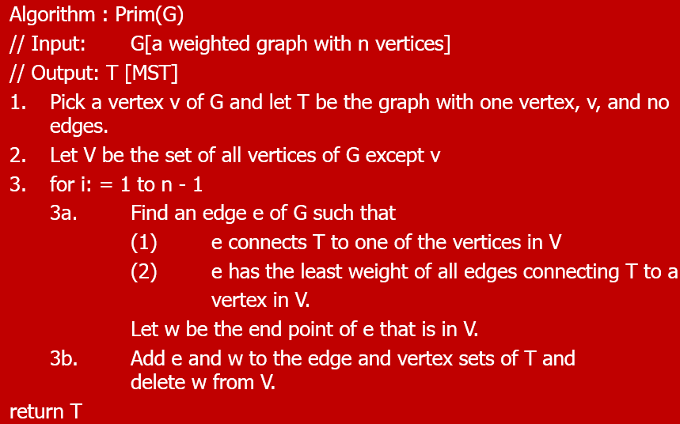
Prim’s Algorithm
b
8
c
7
d
9
4
2
a
11
i
4
e
14
7
6
10
8
h
g
f
1
2
Q
a
b
c
d
e
f
g
h
i
0

Slide 85
Prim’s Algorithm
b
8
c
7
d
9
4
2
root
a
11
i
4
e
14
7
6
10
8
h
g
f
1
2
Q
b
c
d
e
f
g
h
i
4
8

Slide 86
Prim’s Algorithm
b
8
c
7
d
4
9
2
a
11
i
4
e
14
7
6
10
8
h
g
f
1
2
Q
c
d
e
f
g
h
i
8
8

Slide 87
Prim’s Algorithm
8
7
b
c
d
4
9
2
a
11
i
4
e
14
7
6
10
8
h
g
f
1
2
Q
d
e
f
g
h
i
7
4
8
2

Slide 88
Prim’s Algorithm
8
7
b
c
d
4
9
2
a
11
i
4
e
14
7
6
10
8
h
g
f
1
2
Q
d
e
f
g
h
7
4
6
7

Slide 89
Prim’s Algorithm
8
7
b
c
d
4
9
2
a
11
i
4
e
14
7
6
10
8
h
g
f
1
2
Q
d
e
g
h
7
10
2
7

Slide 90
Prim’s Algorithm
8
7
b
c
d
4
9
2
a
11
i
4
e
14
7
6
10
8
h
g
f
1
2
Q
d
e
h
7
10
1

Slide 91
Prim’s Algorithm
8
7
b
c
d
4
9
2
a
11
i
4
e
14
7
6
10
8
h
g
f
1
2
Q
d
e
7
10

Slide 92
Prim’s Algorithm
8
7
b
c
d
4
2
9
a
11
i
4
e
14
7
6
10
8
h
g
f
1
2
Q
e
9

Slide 93
Prim’s Algorithm
8
7
b
c
d
4
2
9
a
11
i
4
e
14
7
6
10
8
h
g
f
1
2
Q


Slide 94
Use Prim’s algorithm starting with vertex a to find a minimal spanning tree of the graph below. Indicate the order in which edges are added to form the tree.
b
7
c
1
4
8
10
e
a
3
d
9
2
5
g
6
f
SOLUTION:
Minimal spanning tree
b
7
c
1
4
e
3
a
d
2
Order of adding the edges:
{a,b}, {b.c}, {c,d}, {d,e}, {e,f}, {f,g}
g
6
f

Slide 95
Your Turn
A power distribution network consists of 8 consumption points labeled A to H. The details of the connections between the consumption points and their respective distances are provided below:
  A <-> C: 15 miles, B <-> C: 20 miles, B <-> D: 25 miles,
  C <-> E: 30 miles, D <-> E: 35 miles, E <-> F: 40 miles, E <-> G: 45 miles,
  F <-> G: 50 miles, F <-> H: 55 miles, G <-> H: 60 miles
  For economic reasons, it is desired to connect power stations to various consumption points in a way that minimizes the total distance covered by the power lines, that is construct the least possible number of power lines to connect the power stations. Find the desire network along with minimum cost.

Slide 96
Applications of Graphs: SHORTEST PATH

Slide 97
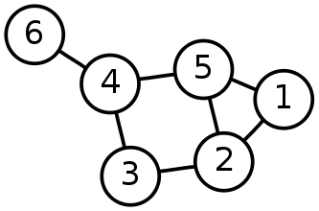
Single-Source Shortest Path Problem
Single-Source Shortest Path Problem - The problem of finding shortest paths from a source vertex v to all other vertices in the graph.

Slide 98
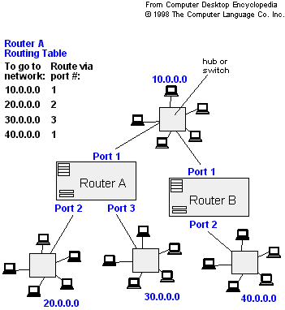
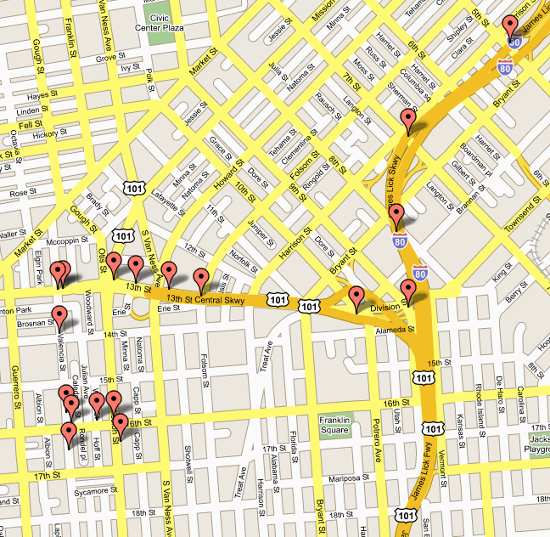
Applications
- Maps (Map Quest, Google Maps)
- Routing Systems

Slide 99
Dijkstra's algorithm
Dijkstra's algorithm - is a solution to the single-source shortest path problem in graph theory.
Works on both directed and undirected graphs. However, all edges must have nonnegative weights.
Input: Weighted graph G={E,V} and source vertex v∈V, such that all edge weights are nonnegative
Output: Lengths of shortest paths (or the shortest paths themselves) from a given source vertex v∈V to all other vertices

Slide 100
Shortest Path
Consider a weighted directed graph
  Each node x represents a city x
  Each edge (x, y) has a number which represent the cost of traveling from city x to city y
Problem: find the minimum cost to travel from city x to city y
Solution: find the shortest path from x to y

Slide 101
Formal definition of shortest path
Given a weighted directed graph G.
Let P be a path of G from x to y.
cost(P) = ∑_{e∈P}weight(e)
The shortest path is a path P which minimizes cost(P)
v₂
v₁
v₃
2
5
4
Shortest Path
3
4
8
v₅
v₄

Slide 102
Dijkstra’s Algorithm
Consider a graph G, each edge (u, v) has a weight w(u, v) > 0.
Suppose we want to find the shortest path starting from v₁ to any node v_{i}
Let VS be a subset of nodes in G
Let cost[v_{i}] be the weight of the shortest path from v₁ to v_{i} that passes through nodes in VS only.

Slide 103
Example
v₂
v₃
v₁
2
5
4
3
4
8
v₅
v₄
 | v | VS | cost[v₁] | cost[v₂] | cost[v₃] | cost[v₄] | cost[v₅]
1 |  | [v₁] | 0 | 5 | ∞ | ∞ | ∞

Slide 104
Example
v₂
v₁
v₃
2
5
4
3
4
8
v₅
v₄
 | v | VS | cost[v₁] | cost[v₂] | cost[v₃] | cost[v₄] | cost[v₅]
1 |  | [v₁] | 0 | 5 | ∞ | ∞ | ∞
2 | v₂ | [v₁, v₂] | 0 | 5 | ∞ | 9 | ∞

Slide 105
Example
v₂
v₁
v₃
2
5
4
3
4
8
v₅
v₄
 | v | VS | cost[v₁] | cost[v₂] | cost[v₃] | cost[v₄] | cost[v₅]
1 |  | [v₁] | 0 | 5 | ∞ | ∞ | ∞
2 | v₂ | [v₁, v₂] | 0 | 5 | ∞ | 9 | ∞
3 | v₄ | [v₁, v₂, v₄] | 0 | 5 | 12 | 9 | 17

Slide 106
Example
v₂
v₁
2
5
v₃
4
3
4
v₅
v₄
8
 | v | VS | cost[v₁] | cost[v₂] | cost[v₃] | cost[v₄] | cost[v₅]
1 |  | [v₁] | 0 | 5 | ∞ | ∞ | ∞
2 | v₂ | [v₁, v₂] | 0 | 5 | ∞ | 9 | ∞
3 | v₄ | [v₁, v₂, v₄] | 0 | 5 | 12 | 9 | 17
4 | v₃ | [v₁, v₂, v₄, v₃] | 0 | 5 | 12 | 9 | 16
5 | v₅ | [v₁, v₂, v₄, v_{3,} v₅] | 0 | 5 | 12 | 9 | 16

Slide 107
Dijkstra’s Algorithm
Algorithm shortestPath()
n = number of nodes in the graph;
for i = 1 to n
cost[v_{i}] = w(v₁, v_{i});
VS = { v₁ };
for step = 2 to n {
find the smallest cost[v_{i}] s.t. v_{i} is not in VS;
include v_{i} to VS;
for (all nodes v_{j} not in VS) {
if (cost[v_{j}] > cost[v_{i}] + w(v_{i}, v_{j}))
cost[v_{j}] = cost[v_{i}] + w(v_{i}, v_{j});
}
}

Slide 108
Your Turn
Consider the following adjacency list. The number in 2nd field represents the weight of corresponding edge.
Draw weighted graph using above adjacency list.
Traverse the graph using BFS starting from node “a”.
Find its Minimum Spanning Tree using Kruskal’s Algorithm.
Find shortest path from source “a” to all other vertices using Dijkstra’s algorithm.

Slide 109
CONCLUSION

